Slide 1
بِسْمِ ٱللَّهِ ٱلرَّحْمَٰنِ ٱلرَّحِيمِ

Slide 2
Course: Web Designing
Institute: Corvit Systems Peshawar
Duration: 3-Month Web Designing & Development Course
class of JS (Java script)
Topic : Arrays & Objects

Slide 3
Instructor: Muhammad Sahil
BS in Computer Science – University of Peshawar
1 Year MERN Stack Developer – E Digital Pakistan (KPITB)
1 Year Web Instructor – E Digital Pakistan
6 Months Web Instructor – University of Peshawar
Computer Science Teacher – Alflah Model College, Sarband
Experience with multiple local client projects
Full Stack / MERN Stack Web Developer | Web Instructor

Slide 4
Introduction to Arrays & Objects
Arrays and objects are data structures used to store and manage data
They help organize multiple values in a single variable
Almost every real application uses arrays and objects
They are the foundation of APIs, databases, and frontend rendering
Understanding them is essential for modern JavaScript development

Slide 5
Arrays Fundamentals
An array is a collection of values stored in order
Each value has an index starting from zero
Arrays are used when data is similar in type or purpose
They are commonly used to store lists such as users, products, or messages
Arrays make data processing and looping easier

Slide 6
Common Array Methods – push & pop
Push() adds a new element at the end of an array
It is used when new data arrives dynamically
pop() removes the last element from an array
It is used when undoing or removing recent data
These methods modify the original array directly

Slide 7
Common Array Methods – forEach
forEach() is used to perform an action on each array element
It does not return a new array
It is mainly used for displaying data or logging information
Commonly used in UI rendering and debugging
forEach() improves readability compared to manual loops

Slide 8
Objects Fundamentals & Structure
An object stores data in key and value pairs
Each key represents a property name
Values can be strings, numbers, arrays, or even other objects or a function
Objects represent real-world entities in code
They are heavily used in APIs and application state

Slide 9
Accessing Object Data
Object properties can be accessed using dot notation i.e student.name
Bracket notation is used for dynamic or variable keys i.e student[ name ]
Objects allow structured and readable data access
They make code more meaningful and organized
Accessing object data is core to working with JSON

Slide 10
Working with Real Data
Real application data comes as arrays of objects
let data = [ {}, {}, {},{} ]
User lists, product catalogs, and API responses follow this structure
Array methods are used to process object data efficiently
Objects represent single records while arrays represent collections
This combination powers dashboards, forms, and dynamic content

Slide 11
Code example Screen shots from next slide

Slide 12
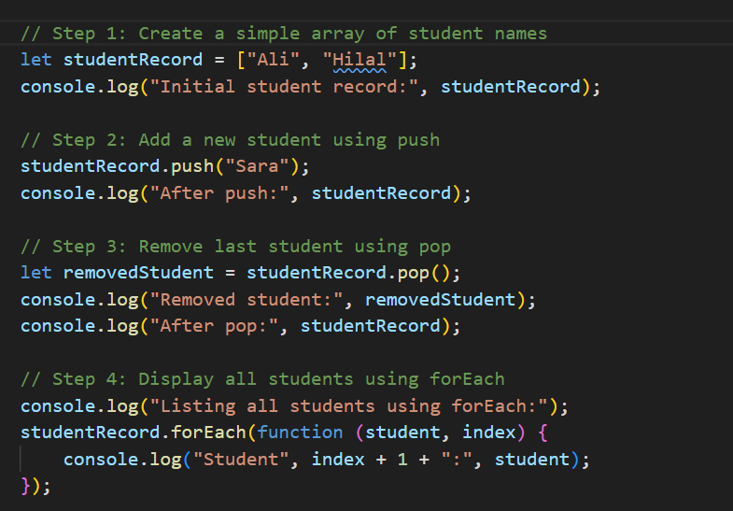
Arrays Code & Concept

Slide 13
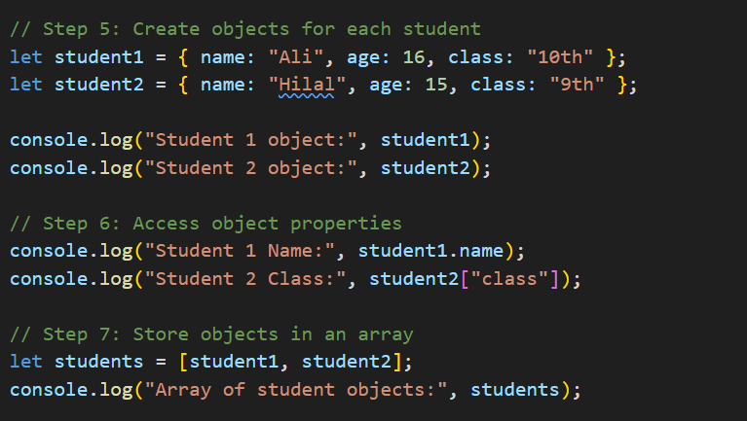
Objects Code & Concept

Slide 14
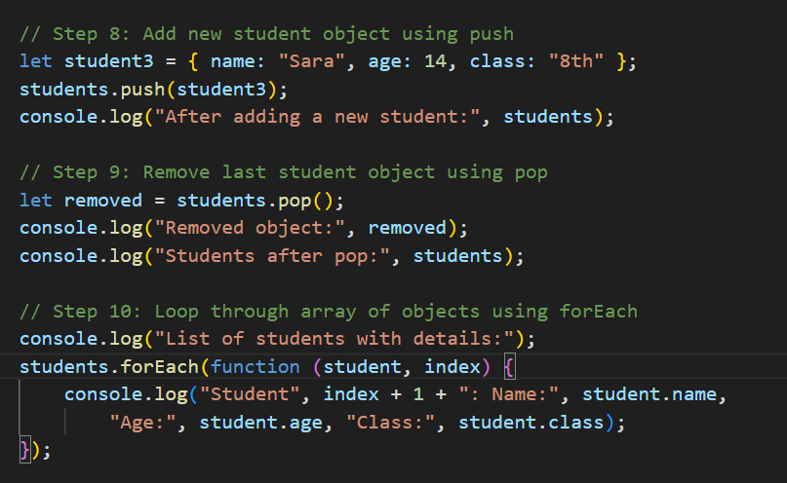
Objects Code & Concept

Slide 15
Summary
Arrays handle multiple items,
Objects describe one item with details,
Together they form real application data.

